Slide 1
Sales Method Analysis
Presented by: Thanakorn Saengsuk
Last updated: April 6th, 2025

Slide 2
Background
Six weeks ago our company launched a new line of office stationery
We have tested three different sales strategies for this, targeted email and phone calls, as well as combining the two in order to approach to customers.
Sales methods:
Email: Required very little work for the team.
Call: Thirty minutes per customer on average members of the team.
Email + Call: Required very little for email, the call was around ten minutes per customer.

Slide 3
Business goal
“Select the most effective sales method
that allows the company to minimize efforts
while maximizing revenue.”

Slide 4
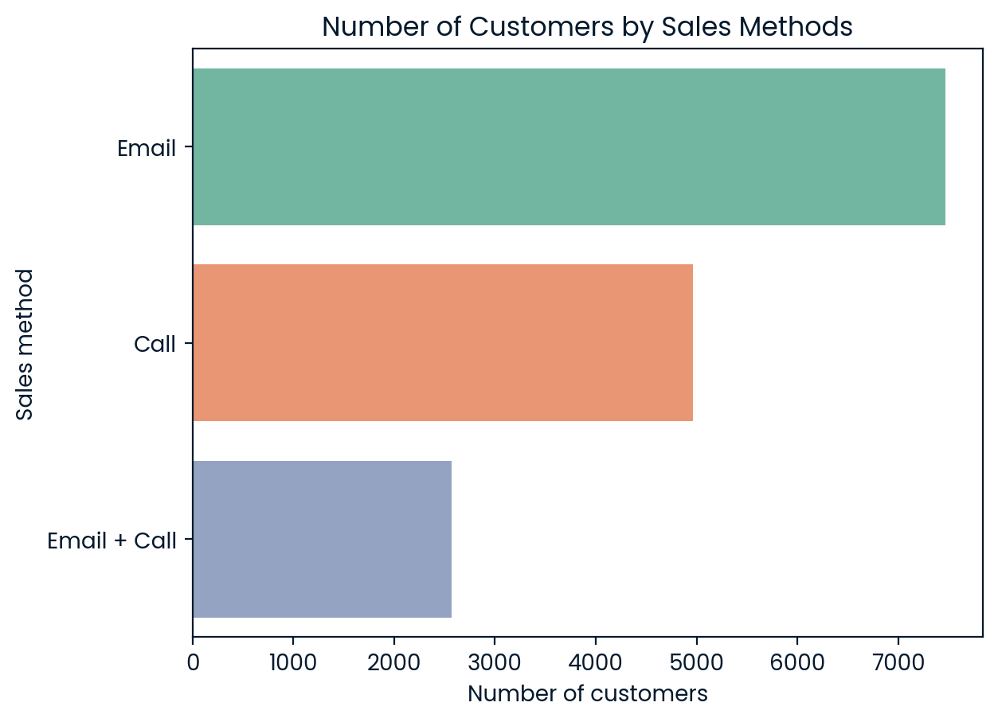
Customers by sales method
The most commonly used sales method has been Email, followed by Call
and Email + Call, respectively.

Slide 5
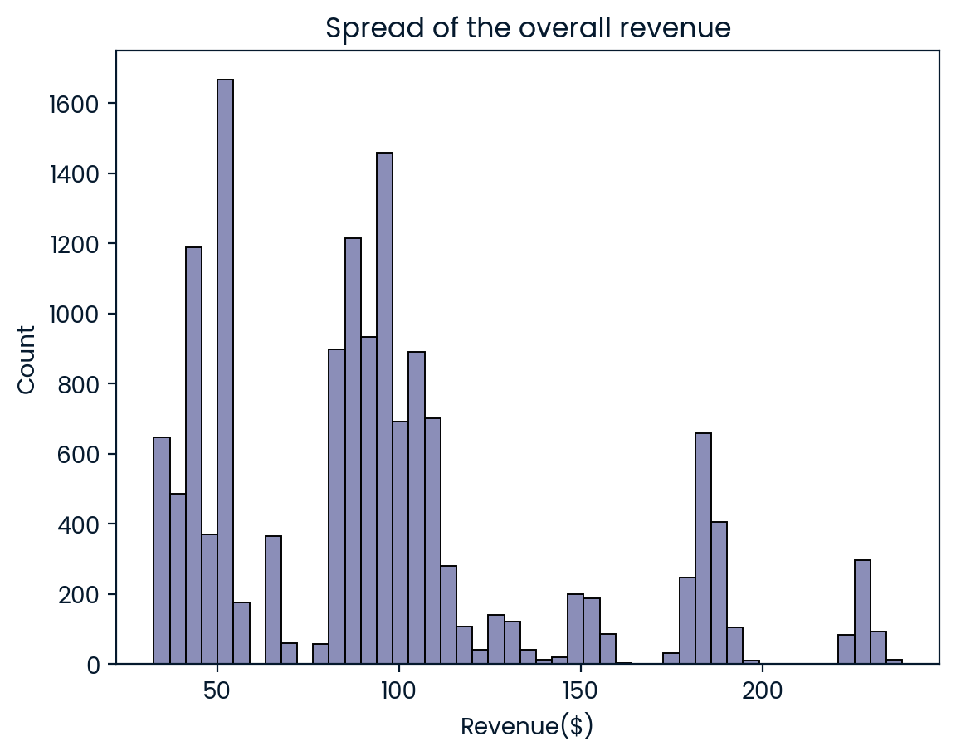
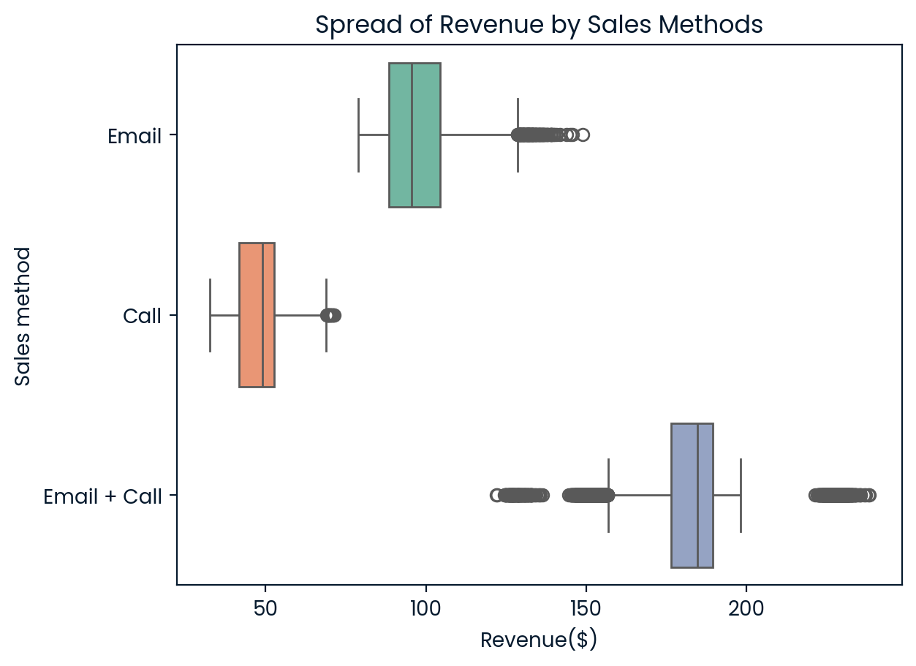
Revenue distribution
The most of the revenue is distributed between 50 and $110 dollars.
The average revenue for the Email + Call method is nearly $190, which exceeds the peak range of the overall distribution.

Slide 6
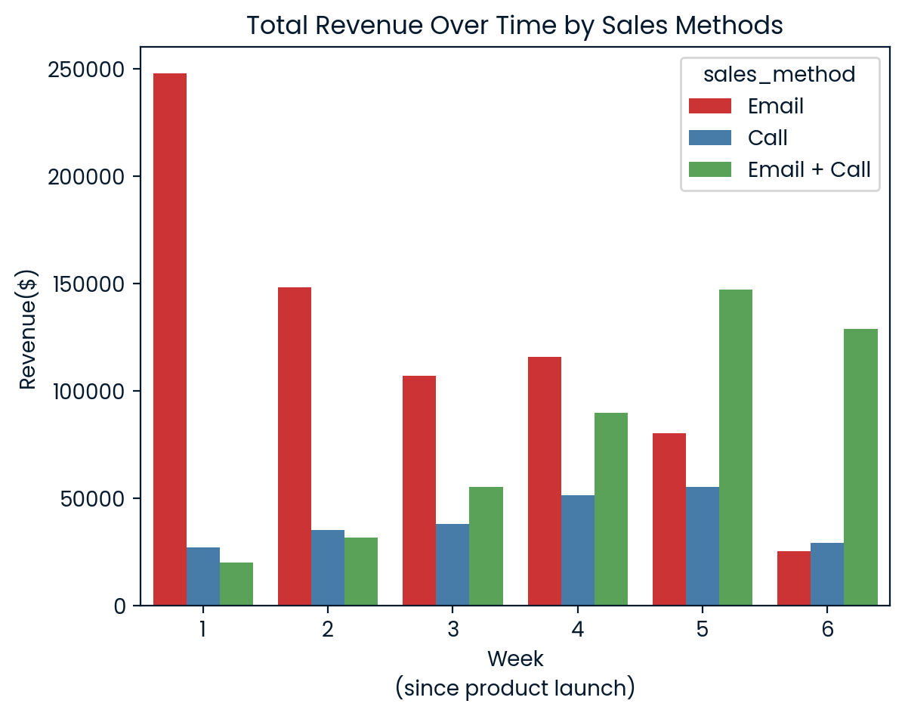
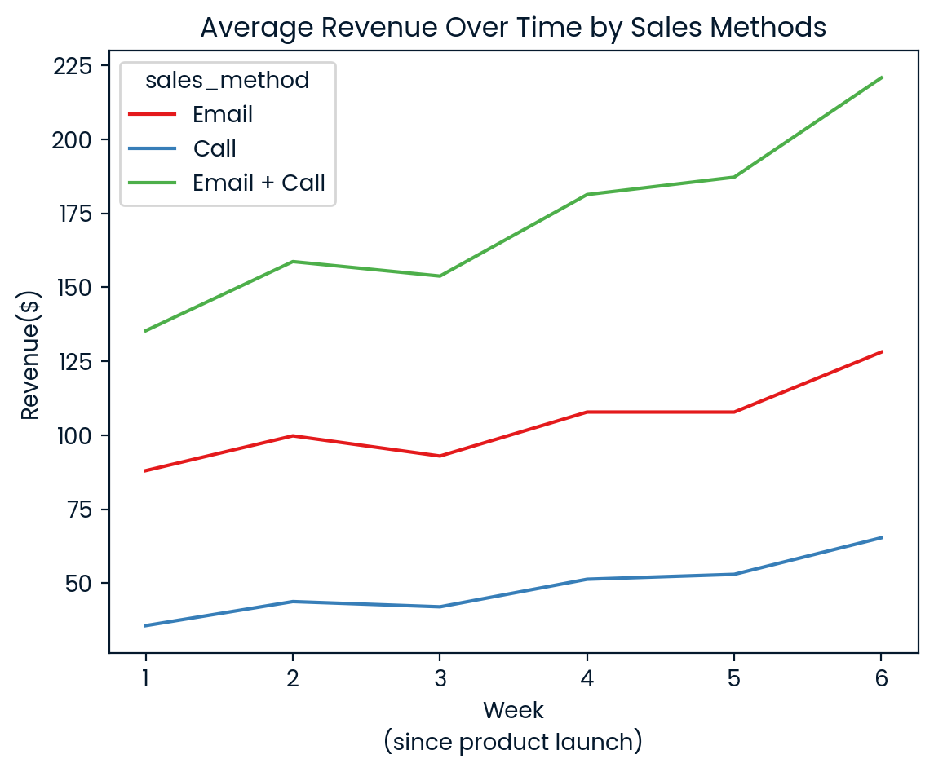
Revenue Overtime
Email method generated the highest revenue. However, its revenue gradually declined week by week. On the other hand, Email + Call showed a significant increase after the sixth week
Average revenue per customer of Email + Call
consistently generated the highest revenue
from the first to the last week

Slide 7
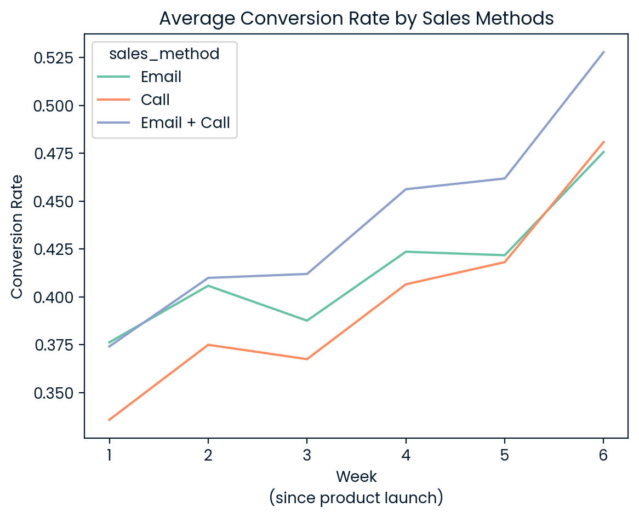
Conversion rate
Average conversion rate for
Email + Call is the highest week by week
NOTE:
Conversion rate = ratio of nb_sold to nb_site_visits.
It describes how many products were purchased by customers relative to the number of website visits.

Slide 8
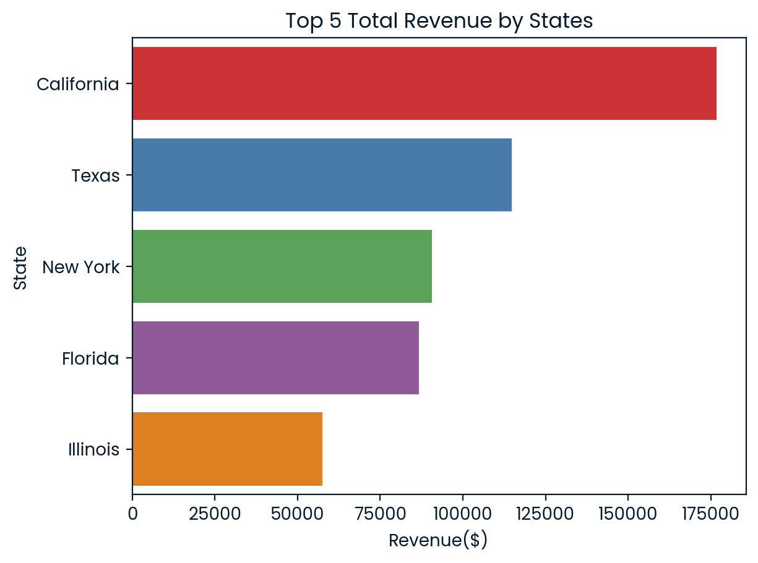
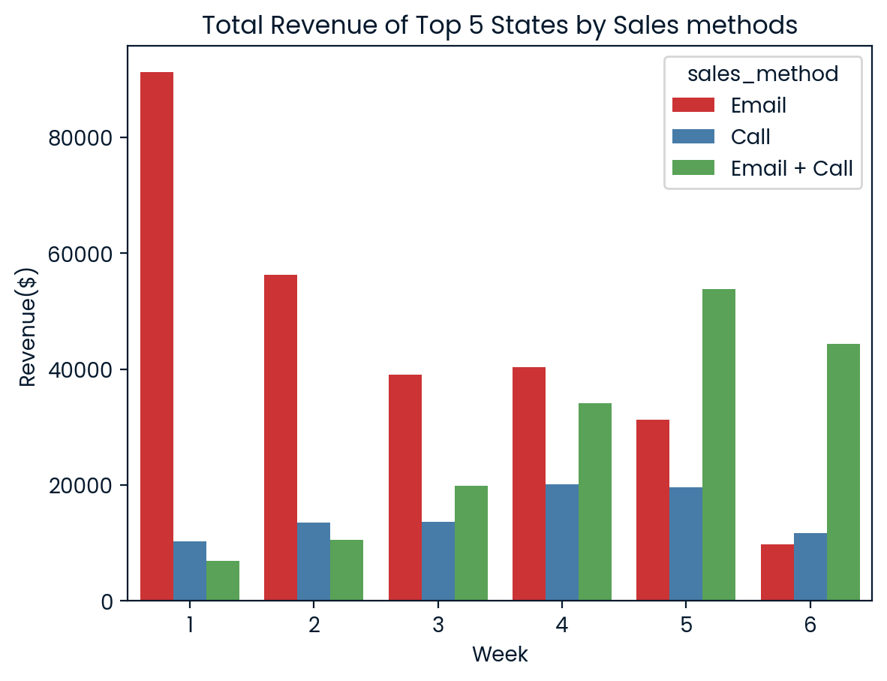
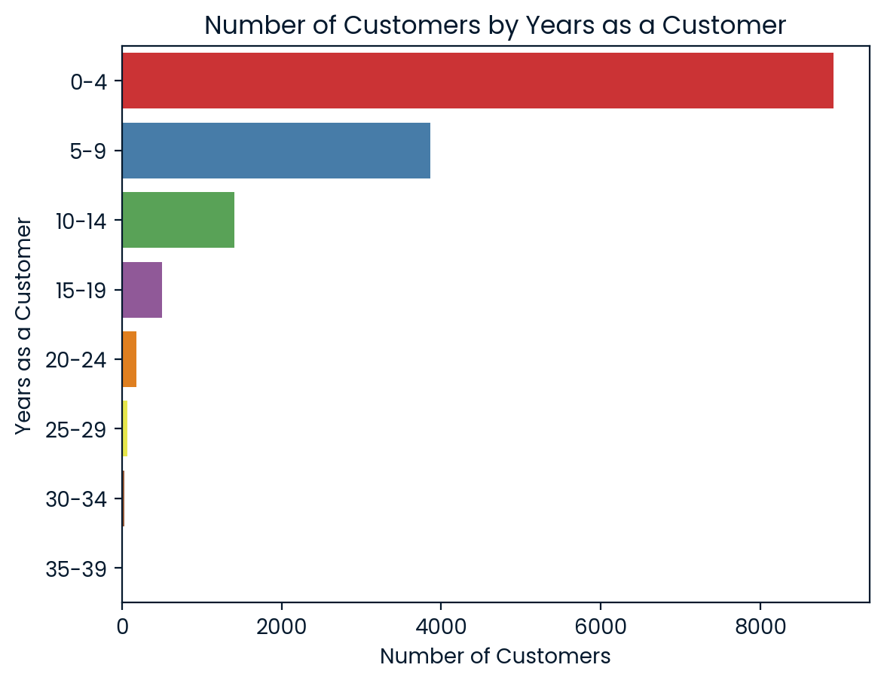
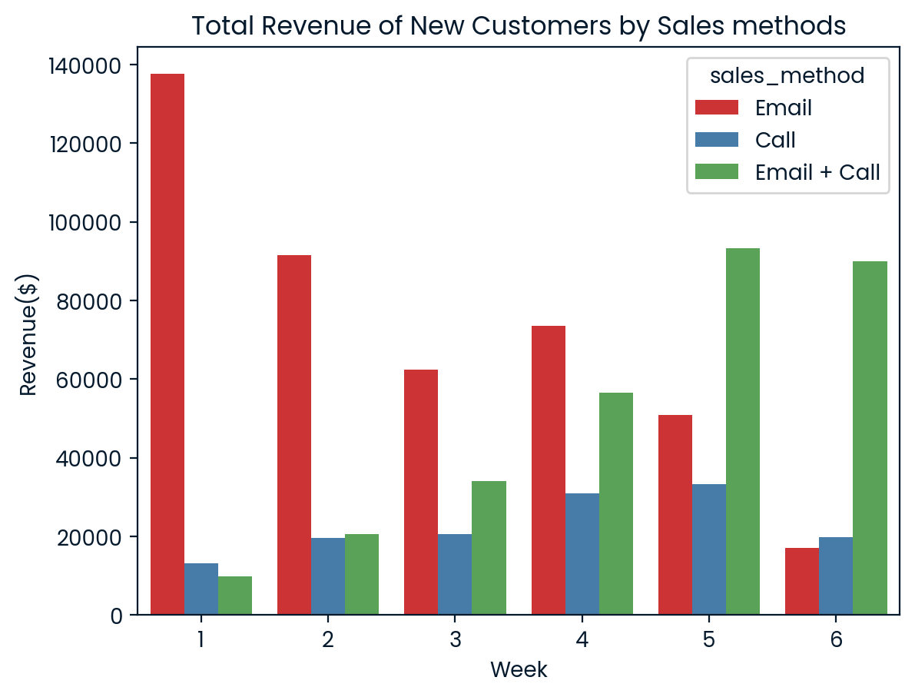
Majority of customer
The top 5 states consist of “California, Texas, New York, Florida, Illinois.
Additionally, it appears that the 0–4 years customer group (new customer) represents the majority of our customer base.

Slide 9
Recommendation
Focus exclusively on Email + Call by evaluating the results over the next 6 weeks to see if we can generate more revenue.
Identify ways to reduce call time to under 10 minutes
in order to optimize time for future processes.

Slide 10
Business metric
Total revenue over the next 6 weeks
Initial value : $1,307,990.32
2. Trend of total revenue by week

